Slide 1
National Resource Concerns Team
Team proposed updated “list of 47” resource concern names to National Technical Guide Committee.
April 2019, NTGC approved changes, including addition of Soil Organism Habitat Loss or Degradation and Aggregate Instability
Team members included:
Aaron Lauster, CPTAD
Barry Fisher, SHD
Bianca Moebius-Clune, SHD
Bill Reck, CED
Brandon Smith, SHD
Brenda Simpson, SO-NM
Candy Thomas, SHD
Casey Sheley, WNTSC
Charles Kome, NSSC
Chuck Schmitt, SO-WY
Clare Prestwich, WQQDT
Dana Ashford, ESD
Danielle Flynn, ESD
Dennis Chessman, SHD
Diane Stott, SHD
Greg Zwicke, AQT
James Eller, SO-ID
Jan Surface, ESD
Jim Lyons, SO-MA
Joseph Bagdon, WQQDT
Karma Anderson, WQQDT
Kerry Goodrich, CNTSC
Lindsay Haines, ESD
Matt Flint, ENTSC
Steve Durgin, CED
Terri Ruch, CED
Notes:
During 2019, a national team was convened to review and update the national list of resource concerns and planning criteria. The team included diverse members from state, regional and national technical backgrounds. By April 2019, the National Technical Guide Committee had voted to approve an updated list of 47 resource concern names. By August, the team presented and earned approval from the NTGC for sets of planning criteria and assessment technology, by land use category, for each resource concern.

Slide 2
CART Soil Quality/Health Resource Concerns Team
State volunteers
Paul DuBort, DC Carrington, ND
Helen Denniston, SRC Little Rock, AR
Jason Undercoffer, Soil Con., Zanesville, OH
Kelly German, State Soil Health Specialist, Nashville, TN
Regional and National volunteers
Barry Fisher, Central Regional Soil Health Team Leader
Brandon Smith, Northeast Regional Soil Health Team Leader
Candy Thomas, Regional Soil Health Specialist
Jason Nemecek, State Soil Scientist
Mark Peters, Senior Econ.
Nathan Lowder, Regional Soil Health Specialist
Notes:
In parallel with the updates to the national list of resource concerns and planning criteria, a team of state, regional and national volunteers was established to identify streamlined assessment methods that could be used in CART to identify presence/absence of seven soil quality and soil health resource concerns with a high level of certainty using remotely sensed information and simple questions observations to the greatest extent possible.
The CART assessment methods are intended to provide streamlined alternative to traditional in-field assessment technology, but they DO NOT rule out use of in-field methods. Planners using the CART assessment will be able to use field collected data to override results from the streamlined assessment.

Slide 3
CART Soil Health Assessments
Planner defines the planning land unit (PLU) and selects when soil health resource concerns are assessed.
SSURGO derived webservices determine percentage of soils in the PLU susceptible to the resource concern.
A service request calculates the rolling sum values for rating acres and rating percent for each resource concern and finds the single most limiting rating (per land unit) that comprises at least 10% by area or 10 acres.
Thresholds are set, based on the webservice results; and the planner is prompted to answer questions about existing conditions to determine the benchmark condition.
Notes:
This is a simplified description of the CART Assessment workflow, emphasizing how webservices derived from SSURGO data inform the assessments.

Slide 4
CART Soil Health Assessments
Subsidence
Soil data derived threshold is fixed (present/absent)
Existing condition based on planner observation of limitation on land use
Compaction
Soil data derived threshold is variable (range of susceptibility)
Existing condition based on planner observation of compacted layers, surface ponding
Organic Matter Depletion
Soil data derived threshold is variable (range of susceptibility)
Soil rating adjusted upward, if irrigated
Existing condition based on planner observation of managements, plant litter, RHA and PCS elements
Notes:
For each resource concern listed, an overview of the CART streamlined assessment method is described. Key concepts for each of these are:
“thresholds” (treatment/attainment goals used in lieu of planning criteria by CART)
Thresholds are either fixed @ 50 points, or are vary between 40 and 60 points depending on the site’s soil characteristics
Existing conditions (a.k.a. benchmark condition) are indicated by planner answered questions
Practice points (for existing and planned practices) are applied in the assessment to indicate the levels of conservation relative to the applicable threshold for the land.

Slide 5
Example: sliding thresholds based on soil interp. and existing points matrix crossing soil interp. and management questions
 |  | Existing Condition Points
Soil Interp | Variable Thresholds | Rapidly Depleting SOM | Depleting SOM | Maintaining SOM | Not assessed
Soil highly capable of accumulating OM (Low vulnerability to depletion) | 40 | 0 | 10 | 40 | -1
Soil moderately capable of accumulating OM (Moderate vulnerability to depletion) | 50 | 0 | 10 | 50 | -1
Soil barely capable of accumulating OM (High vulnerability to depletion) | 60 | 0 | 10 | 60 | -1
Not rated | 50 | 0 | 10 | 50 | -1
Notes:
This is an example of how the soil webservices are used to establish thresholds that vary according to an interpretation of planning units soil capabilities and limitations for a soil health resource concern.

Slide 6
CART Soil Health Assessments
Concentration of Salts or Other Chemicals
Soil data derived threshold is variable (range of susceptibility)
Existing condition based on planner observation of damage, soil test, water test, RHA, PCS indicators
Soil Organism Habitat Loss or Degradation
Soil data derived threshold is variable (range of susceptibility)
Soil rating adjusted upward, if irrigated
Existing condition based on planner observation of managements, plant litter, RHA and PCS elements
Aggregate Instability
Soil data derived threshold is variable (range of susceptibility)
Existing condition based on planner observation of managements, plant litter, RHA and PCS elements
Notes:
Maintaining SOM represented the idea of ‘sustainability’, therefor should be set as the CART threshold.
Conservation Practices can be used to meet the threshold, except on non-irrigated land with soil having a high vulnerability to SOM depletion.
CSP enhancements can be used to take land past the threshold into the “building SOM” category.
Need to add practice points for irrigation b/c it modifies the climate.

Slide 7
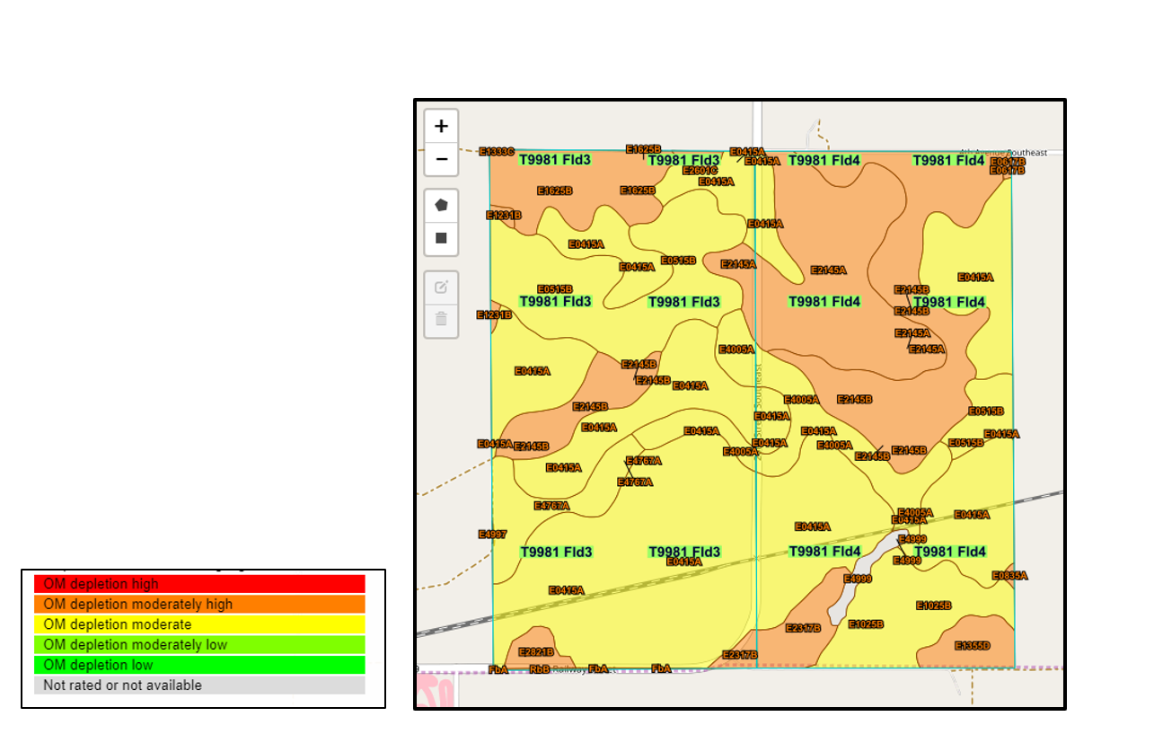
Example for Proposal #6: Thematic Soil Map
Organic Matter Depletion
Notes:
This slide provides a screen capture of the thematic map output that can be generated from the soil webservices for a planning land unit. Color intensities indicate soil ratings for the Organic Matter Depletion resource concern. It is intended to add this map generation feature within the CART assessment, to aid planners and support decision-making by their clients.

Slide 8
Future Development, Outcomes for SS Opportunities
https://github.com/jneme910/CART
Prototype https://jneme910.github.io/CART/documents/rev00_Organic_Matter_Depletion.html
Notes:
This slide provides hyperlinks to soil health interpretation refence materials, developed by Jason Nemecek, State Soil Scientist in Wisconsin and Steve Peaslee GIS Specialist at the National Soil Survey Center

